Slide 1
Space-to-time conversion: oscillations in a DNN generate a temporal code

Slide 2
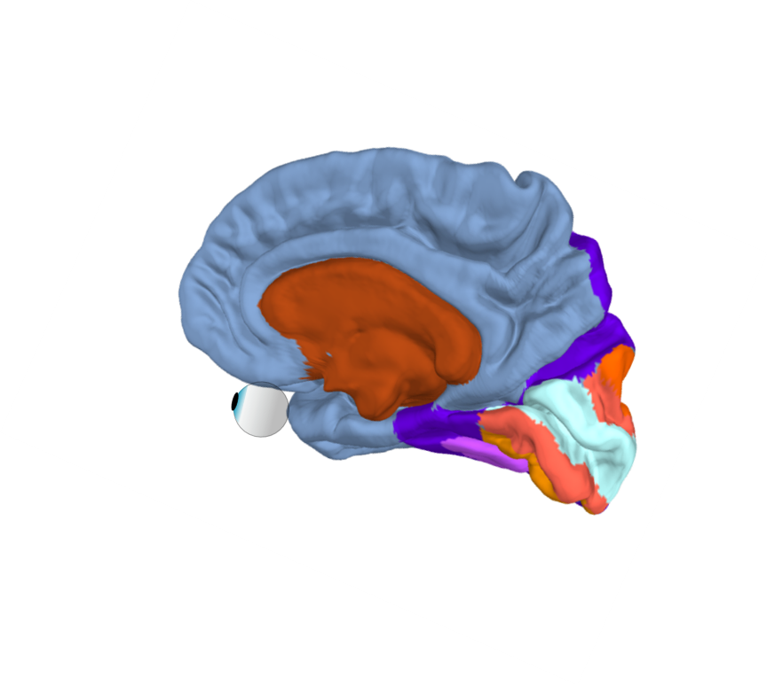
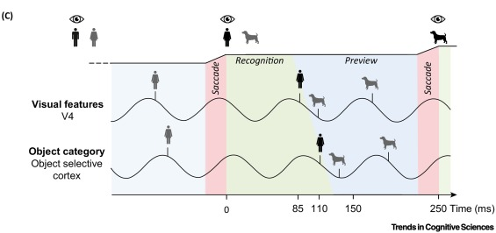
Hypothesis: alpha-gamma temporal code solves bottleneck problem in ventral stream
Alpha (8-12 Hz)
Gamma (>30 Hz)

Slide 3
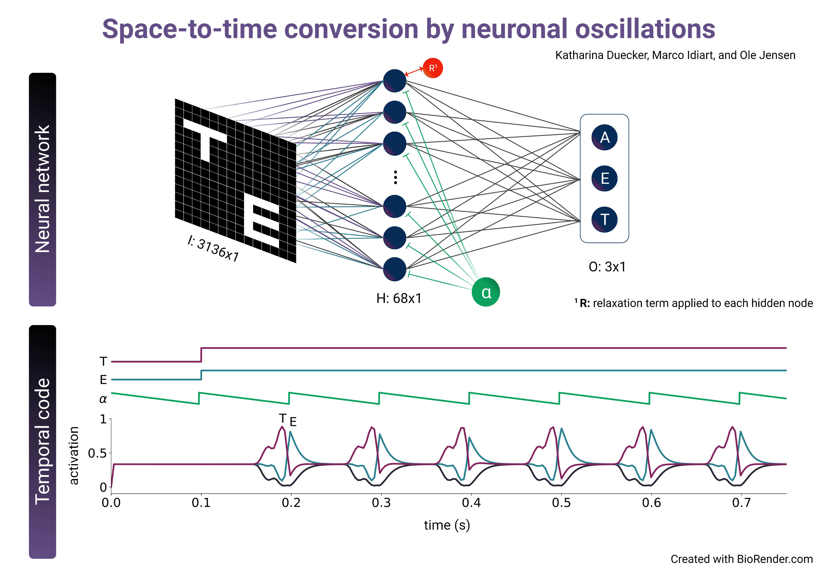
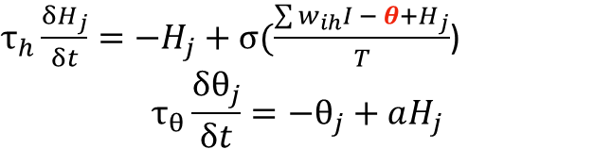
Toy model: Space-to-time conversion by alpha oscillations
Adaptation term: un-sustained activation
$τ_{h}\frac{{δH}_{j}}{δt}=−H_{j}+σ(\frac{\sum{w_{ih}I − θ+}H_{j}}{T}$)
$$τ_{θ}\frac{δθ_{j}}{δt}=−θ_{j}+aH_{j}$$
θ
Weight sharing:
convolutional kernel
sliding over quadrants
Pulsed inhibition
$τ_{h}\frac{{δH}_{j}}{δt}=−H_{j}+σ(\frac{\sum{w_{ih}I − θ−α(t)+}H_{j}}{T}$)

Slide 4
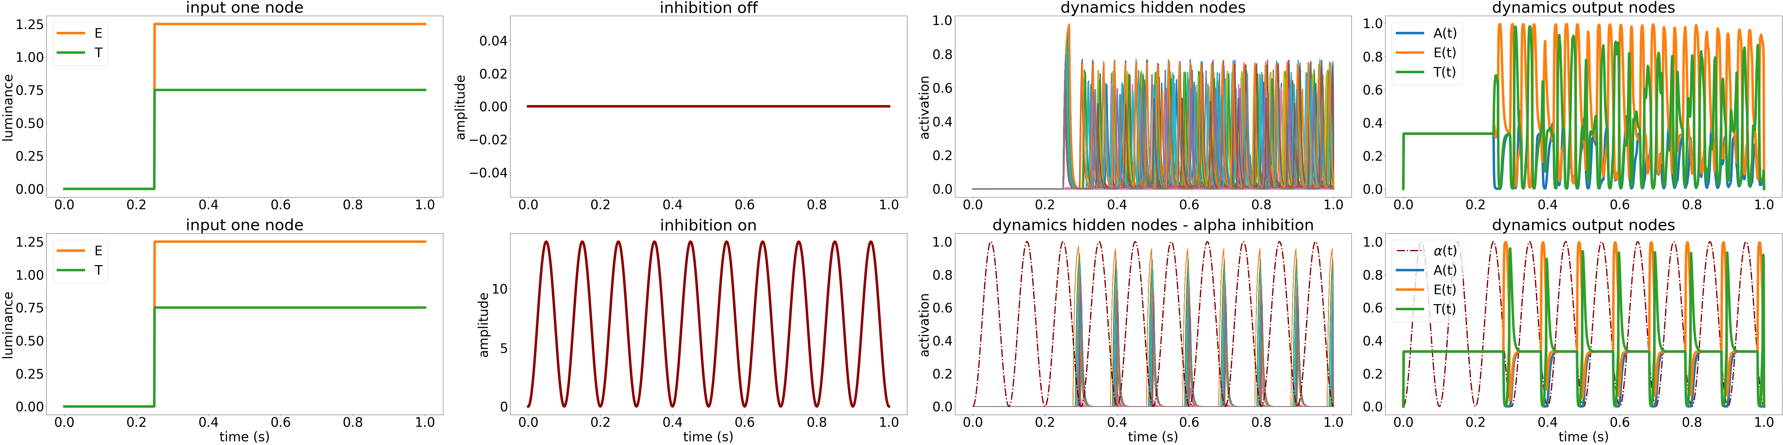
Toy model: Space-to-time conversion by alpha oscillations

Slide 5
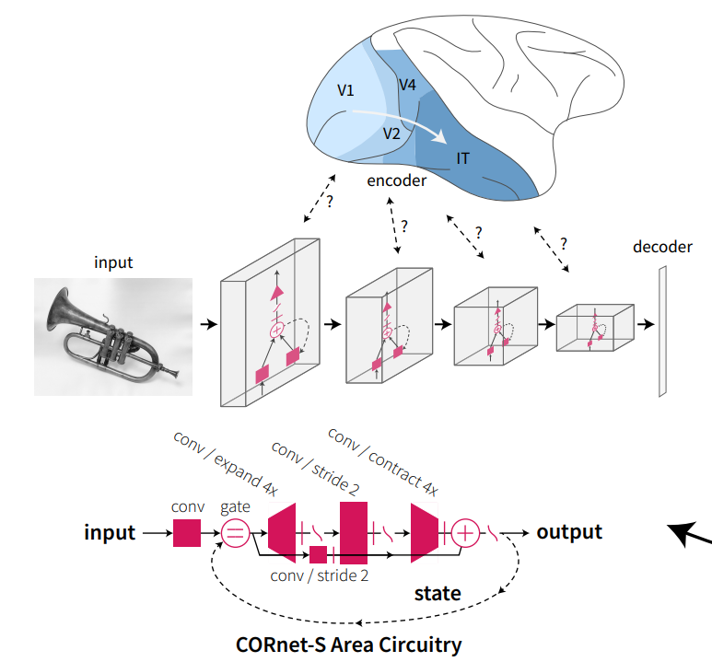
Goal: temporal code in biologically plausible network
Steps
Add linear decoder to CORnet-Z (Kubilius 2019) & train on single letters
Implement dynamical function that generates oscillations capped at activation of the hidden node
Add dynamics to the decoder

Slide 6
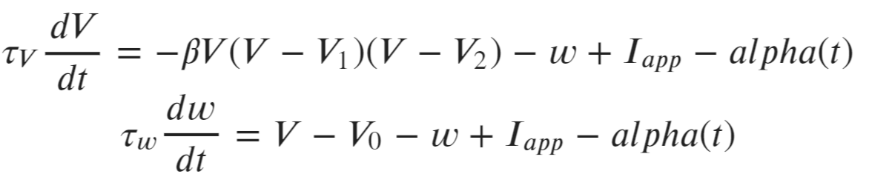
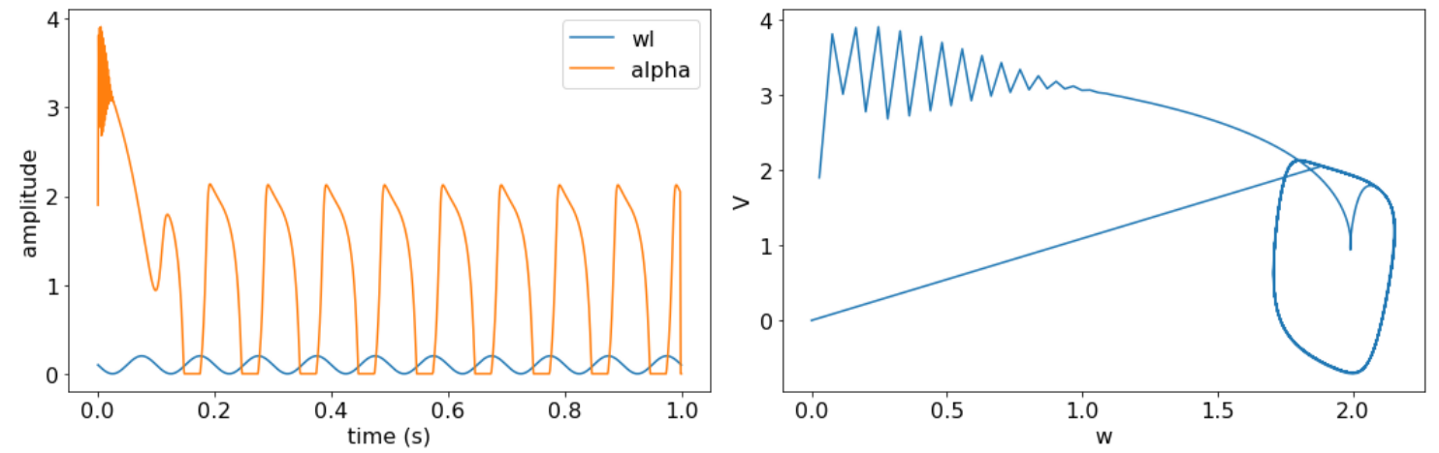
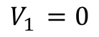
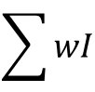
FitzHugh-Nagumo function
$$\sum{wI}$$
$$V_{1 }=0$$
\

Slide 7
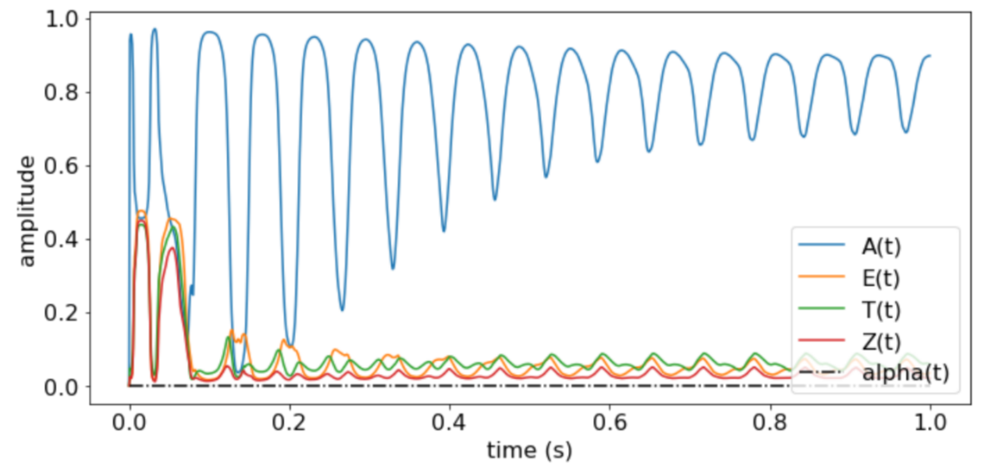
Dynamics in decoder
Alpha amplitude = 0

Slide 8
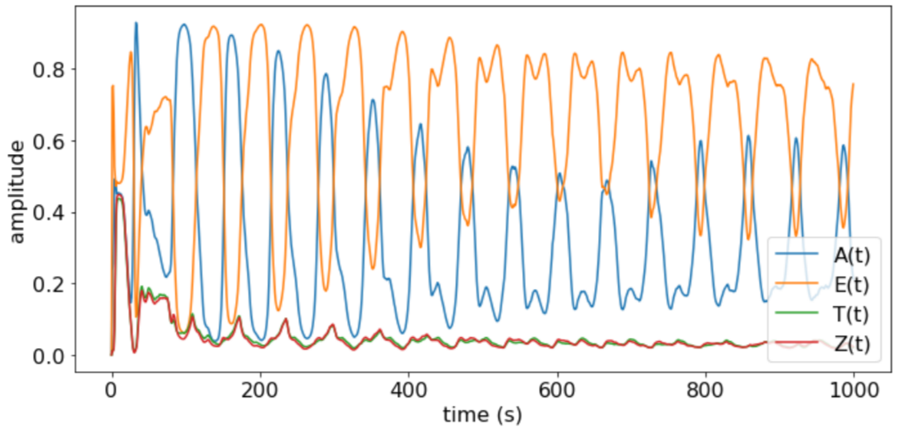
Dynamics in decoder
Alpha amplitude = 0

Slide 9
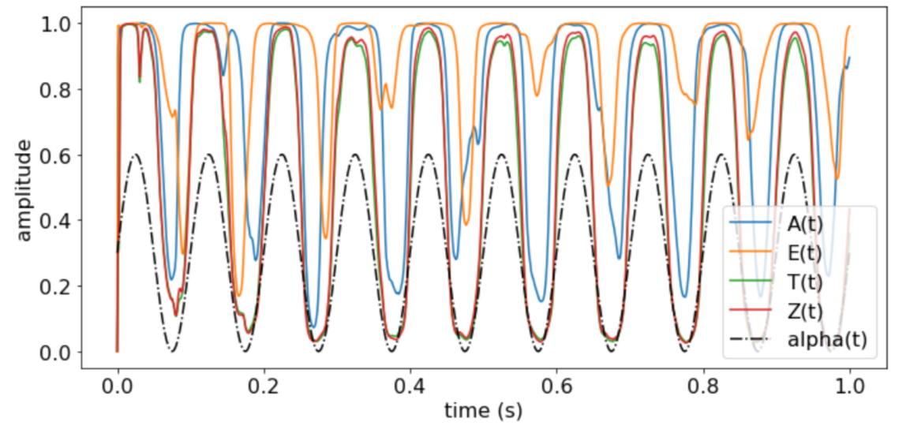
Dynamics in decoder
Alpha amplitude = 0

Slide 10
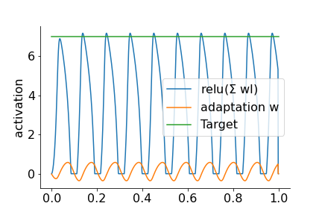
Goal: temporal code in biologically plausible network
Steps
Add linear decoder to CORnet-Z (Kubilius 2019) & train on single letters
Implement dynamical system function that generates oscillations capped at activation of the hidden node
Find layer in which hidden representations are ~additive (V1)
Implement dynamics in layer V1
“Tangledness”
~30 degr
~40 degr

Slide 11
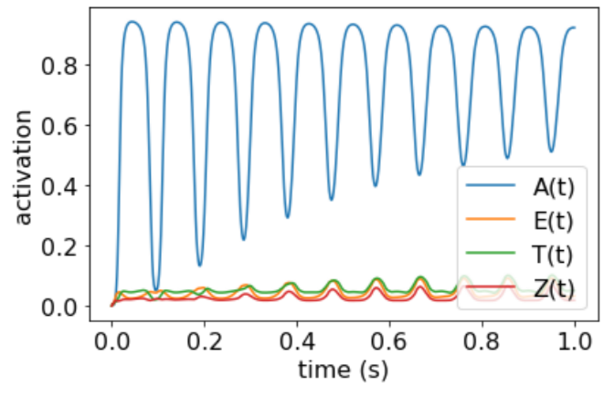
Dynamics in V1
Alpha amplitude = 0

Slide 12
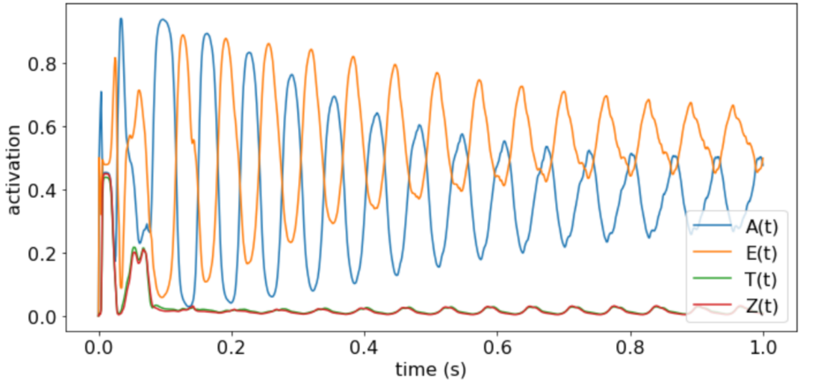
Dynamics in V1
Alpha amplitude = 0

Slide 13
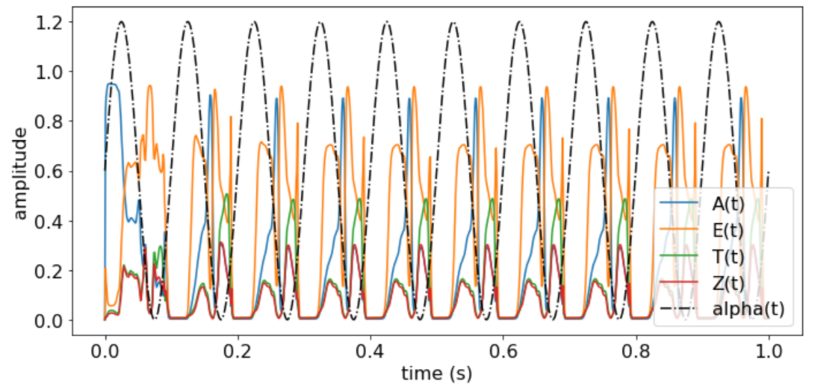
Dynamics in V1

Slide 14
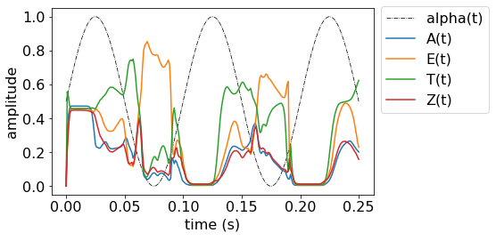
Dynamics in V1

